Slide 1


「互聯網+」商業創新
- 您未來事業的首選
香港城市大學
資訊系統學系工商管理學士 JS1004
“Internet+” Business Innovation
Careers of the Future
Notes:
香港城市大学資訊系統學系工商管理學士学位注重于「互聯網+」商業創新教育，为智慧商業社會發展培育智慧型管理人才，是您未來事業的首選。
Department of Information Systems at City University of Hong Kong educate graduates with knowledge and skills in “Internet+” Business Innovation, we nurture smart people for smarter business. It is your career choice of the future.

Slide 2






「互聯網+」商業創新
“Internet+” Business Innovation
Notes:
过去10年，“互联网+”公司发展迅速，如腾讯公司在2003年香港上市，股票上涨超过200倍。
“Internet+” companies grow rapidly in the past 10 years, e.g. Tencent was listed in HKeX in 2003 and its stock price has increased 200 times since then.

Slide 3
「互聯網+」
“Internet +”
移動應用Mobile Apps
大數據Big Data
社交網絡Social Networks
雲端服務Cloud Services
Notes:
「互聯網+」包括：社交网络、移动应用、大数据分析、云端服务等。
“Internet+” includes social networks, mobile applications, big data analytics and cloud services, etc.

Slide 4









「互聯網+」金融服務
Smart Big Data Analysis for Financial Services
Notes:
「互聯網+」金融服務注重于利用大数据分析，创新金融服务等.
“Internet+” Financial services focus on application of big data analytics for innovative financial services.

Slide 5
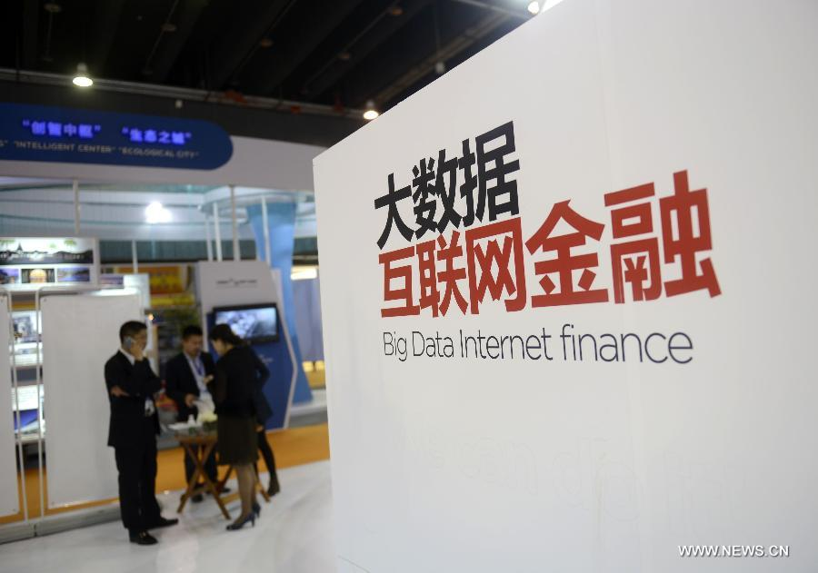

互聯網金融
Smart Financial Services
Notes:
互联网金融利用互联网和移动互联网技术，创新现有的金融服务。
Internet Finance is a new form of financial services with disruptive Internet and Mobile technologies.

Slide 6
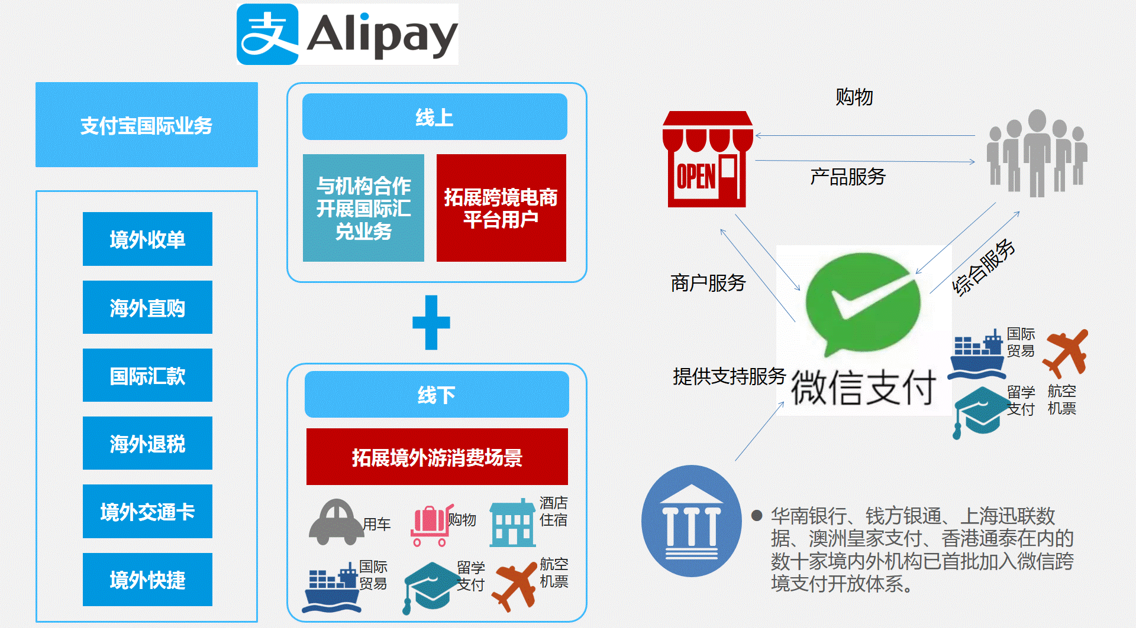
移動支付
Financial Technology (FinTech)
Notes:
移动支付是发展最快的行业之一。据有关统计，在中国大陆，2015年手机移动端上的流动金额已经占资金总数的50%。
Mobile payment is one of the fast growing industries. According to a survey, the cash flow in mobile devices had reached 50% of the total cash amount in the mainland China in 2015.

Slide 7

眾籌
CrowdFunding
Notes:
众筹也是互联网金融发展最快的领域之一。未来要实现你的理想，不仅可以向银行借钱，更多的也可以向社会大众筹钱去发展你的事业。
CrowdFunding is also a fast growing area of the Internet Finance. To realize your dream, you not only can borrow money from banks, but also raise money from friends through crowdfunding.

Slide 8





「互聯網+」審計
Smart IS Auditing for Cloud Services
Notes:
工业界已经将服务转移到云端，因此对云服务的安全、风险管理以及是否满足行业的规章制度要求有很高的需求。4大会计行对资讯系统审计人员的需求也是越来越大。
Industries are moving their services or applications to the cloud. It creates a need to manage the risk and to ensure that the cloud services can meet the rules and regulations in the industry. There is a great demand for IS auditors in big 4 consulting firms.

Slide 9
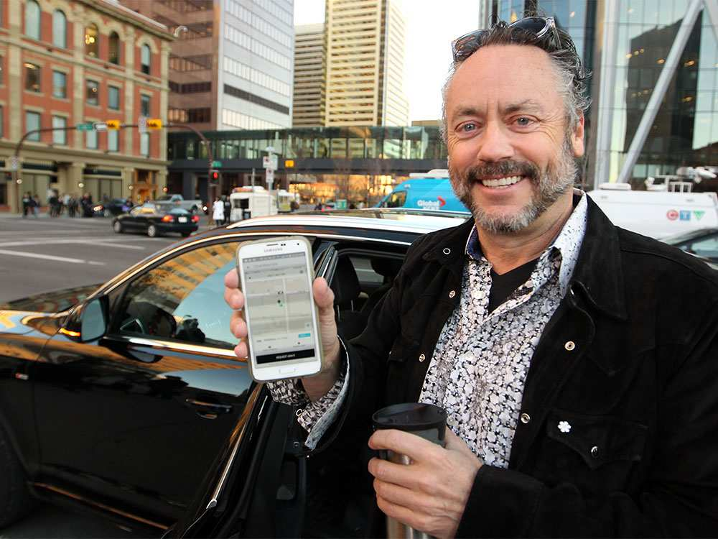

「互聯網+」服務
Smart Online Services
共享經濟
Notes:
“共享经济”是当今社会最热的经济增长点。Uber与AirBnB等公司通过网络平台，直接连接供给方与需求方，最有效地提高了社会的效率。
“Shared economy” is one of the fast growing economy. Companies like Uber and AirBnB make use of network platforms to connect suppliers with demanders, it greatly increased efficiency of the whole society.

Slide 10





社交媒體與社交網絡
Social Media and Social Networks
Notes:
社交媒体与社交网络正在成为社会主流，并逐步改变人们交流与阅读新闻的习惯。
Social media and social networks are becoming social norms and are changing the way people communicate and read news.

Slide 11
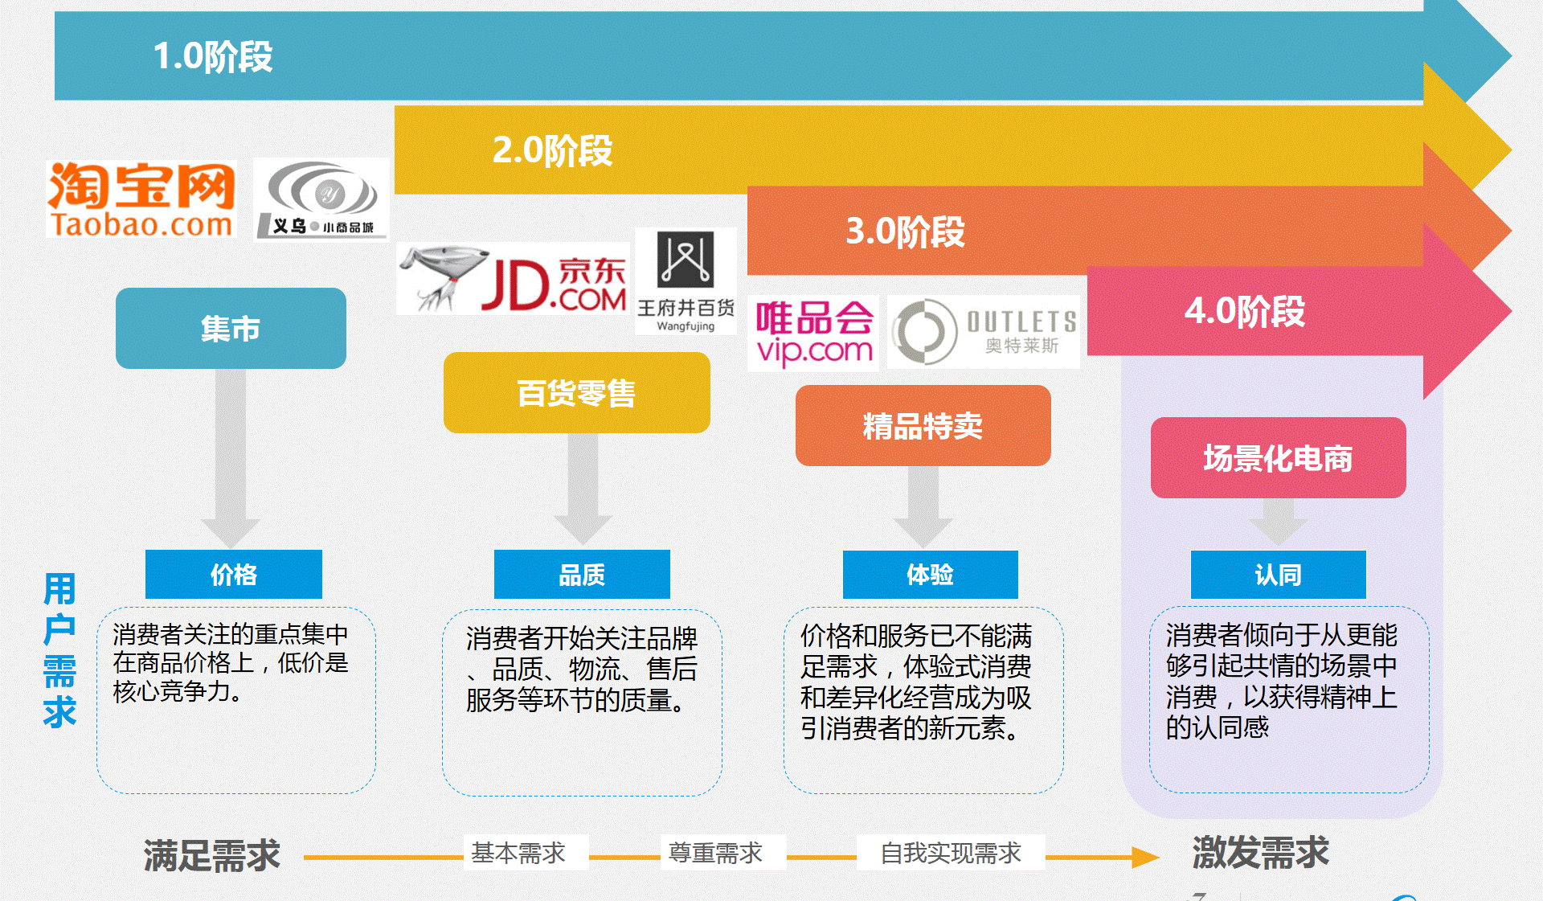
電子商務 4.0
Notes:
电子商务也在不断地演化，从满足需求到自我实现需求与激发需求的转变。
eCommerce is also evolving rapidly, from meeting user requirements to self-realizing the requirements and creating new requirements.

Slide 12






「互聯網+」投資
Smart Global TechBiz Investment
科技發展
商業模式
市場計劃
財務分析
投資計劃
Notes:
如果你是我们的環球商業系統管理学士毕业生，你具备了互联网科技发展、商业模式、投资分析以及财务分析等知识与技能，你将知道如何投资“互联网+”创新企业，可以获得很高的投资回报。
If you are our graduates of Global Business Systems Management (GBSM), you will possess the knowledge and skills in Internet+ technologies, business models, market analysis and financial analysis. You will have high return by investing in “Internet+” technology business.

Slide 13
BBA Majors for “Internet+” Business Innovation
GBSM
ISSN
BI
ISA
Specialization
S
Social
M
Mobile
A
Big Data
Analytics
C
Cloud
Services
GBSM: Global Business Systems Management
IM: Information Management
-ISSN: Internet Services and Social Networks
-BI: Business Intelligence
-ISA: Information Systems Auditing
Department of Information Systems
City University of Hong Kong
www.cityu.edu.hk/is/bbais
Foundation
Careers of the Future
Notes:
香港城市大学資訊系統學系工商管理學士学位注重于培养「互聯網+」商業創新人才，是您未來事業的首選。
我们的专业包括：
环球商业系统管理(GBSM)
资讯管理(IM)
商务智能 (BI)
信息系统审计 (ISA)
互联网服务及社交网络 (ISSN)
Department of Information Systems at City University of Hong Kong educate graduates with knowledge and skills in “Internet+” Business Innovation, we nurture business leaders with careers of the future.
Our majors and streams include:
Global Business Systems Management (GBSM)
Information Management (IM)
-Internet Services and Social Networks (ISSN)
-Business Intelligence (BI)
-Information Systems Auditing (ISA)

Slide 14
「互聯網+」商業創新
互聯網+
金融
審計
服務
投資
您未來事業的首選
Notes:
“互联网+”商業創新= 「互聯網+」金融，審計，服務，投資，是您未來事業的首選。
“Internet+” = Internet+ Financial Services, Auditing, Services and Investment, it is your career choice of the future.

Slide 15
獎學金
資訊系統學系獎學金 (總額高達$500,000)
  Entrance Scholarships
  ISmart Scholarships for Elites
  ISmart Professional Development Awards
  ISmart Student Exchange Awards
大學入學獎學金
  「城大香港精英獎學金」 $60,000
  4 科或以上5**級, 中文或英文科取得4級或以上
Notes:
香港城市大学資訊系統學系为优秀的学生提供丰厚的学生奖学金，總額高達$500,000元/年。
Department of Information Systems at City University of Hong Kong offers competitive scholarships with total of $500,000 per year for qualified students.

Slide 16

香港城市大學
資訊系統學系工商管理學士 JS1004
www.cityu.edu.hk/is/bbais
Notes:
香港城市大学資訊系統學系致力於为智慧商業社會發展培育智慧型管理人才。
Department of Information Systems at City University of Hong Kong is committed to nurture smart people for smarter business.

